Slide 1
Allocation Optimization Algorithm
Viveka Cheekati

Slide 2
Problem
Assign resources (personnel) to appropriate projects
First, assign to higher priority projects
If not enough personnel
Requirements of needed personnel

Slide 3
Method
Dynamic Programming
Tabulation (Bottom-Up)
Personnel cannot be assigned there
if already assigned here (and here)

Slide 4
How Method Works
Step 1 (optional): Prioritize projects
Step 2: Assign personnel
Step 3: Personnel requirements for unassigned projects
Order by traits
By other traits
If missing, then list out traits

Slide 5
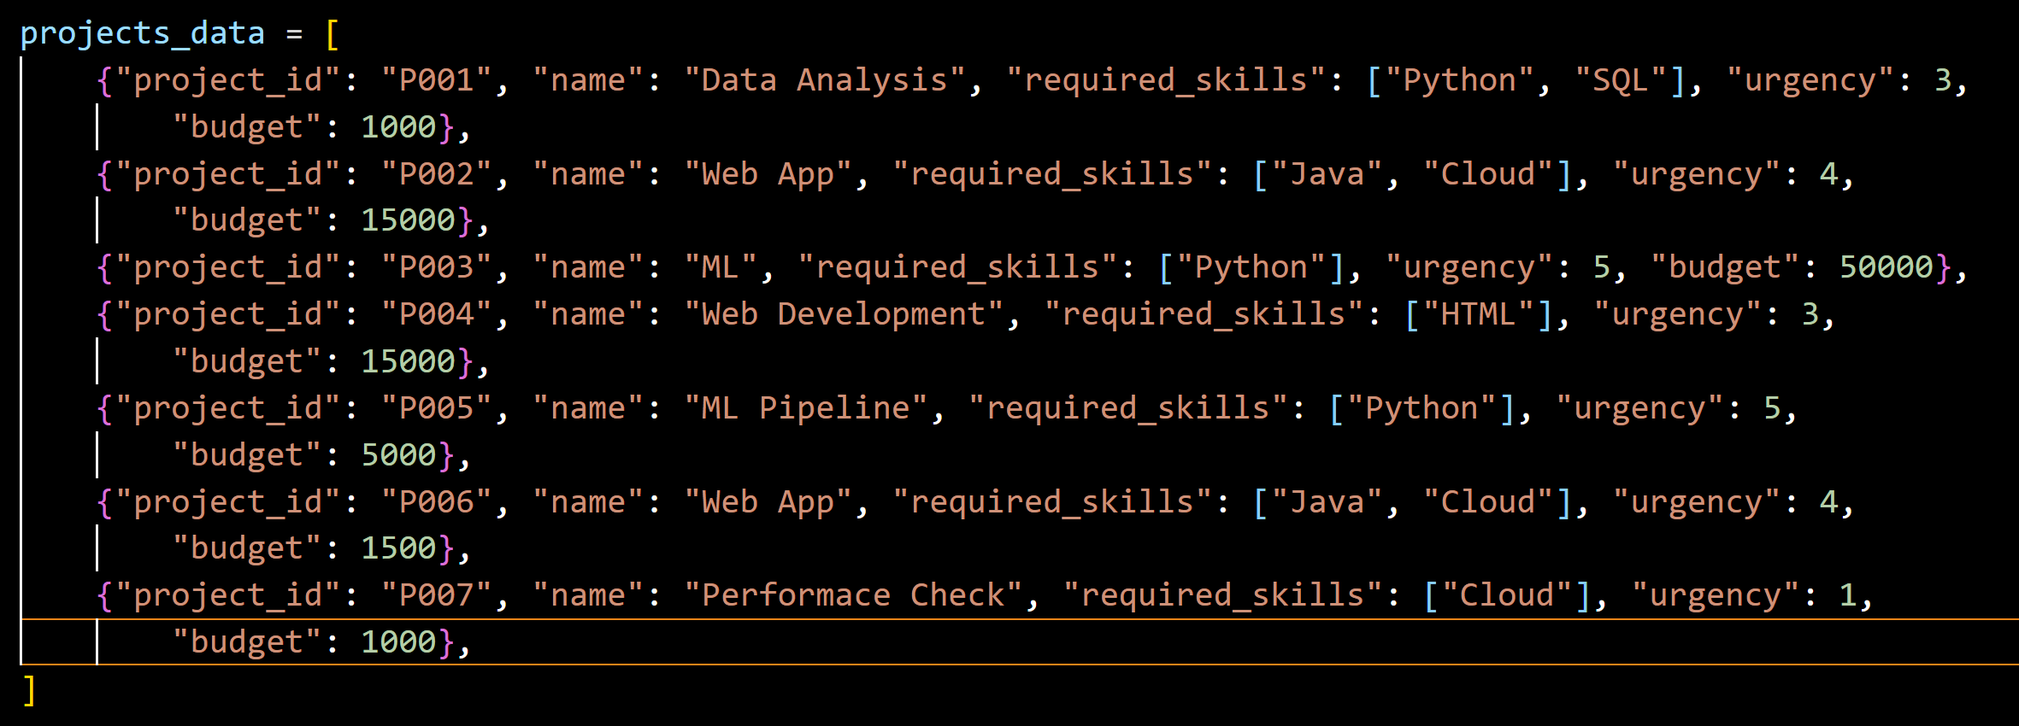
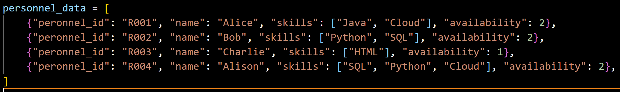
Data
Personnel / Resources
Projects

Slide 6
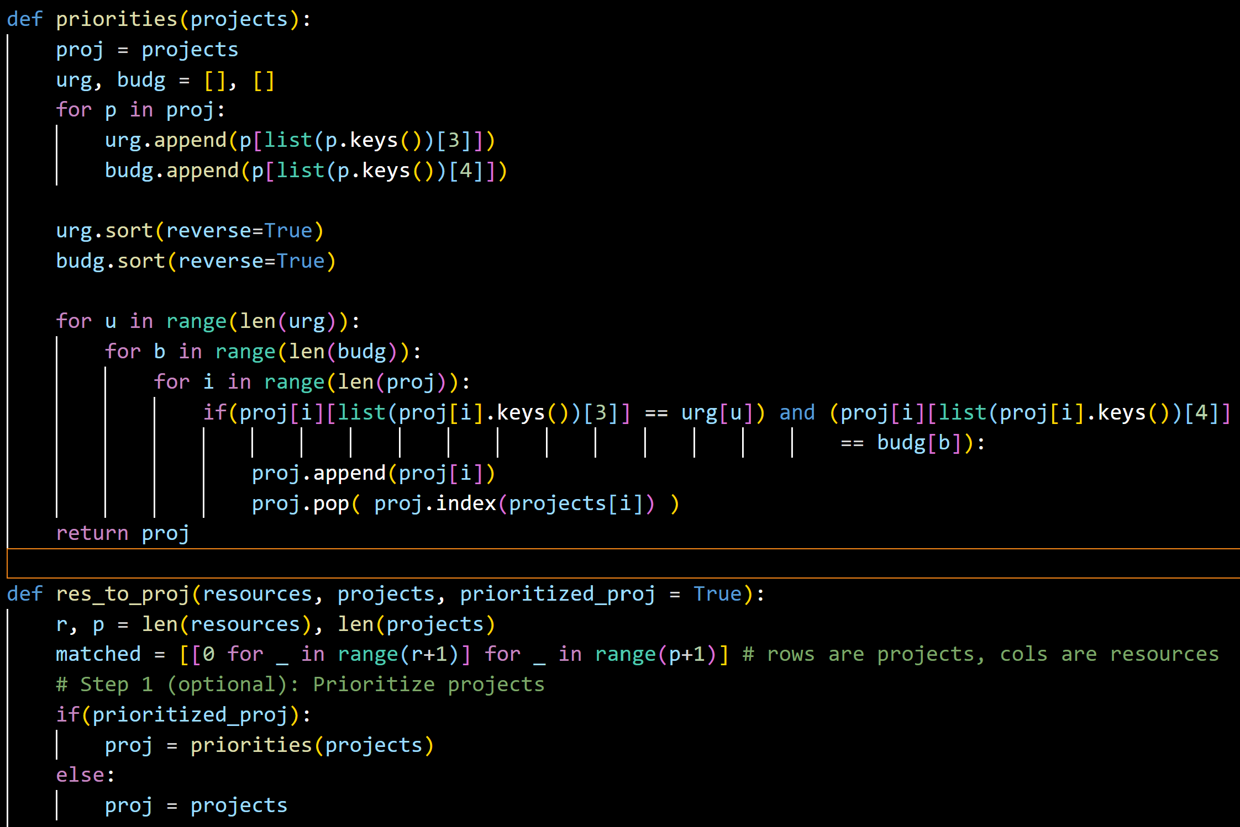
Step 1 (optional): Prioritize projects
Order projects
Urgency
Budget

Slide 7
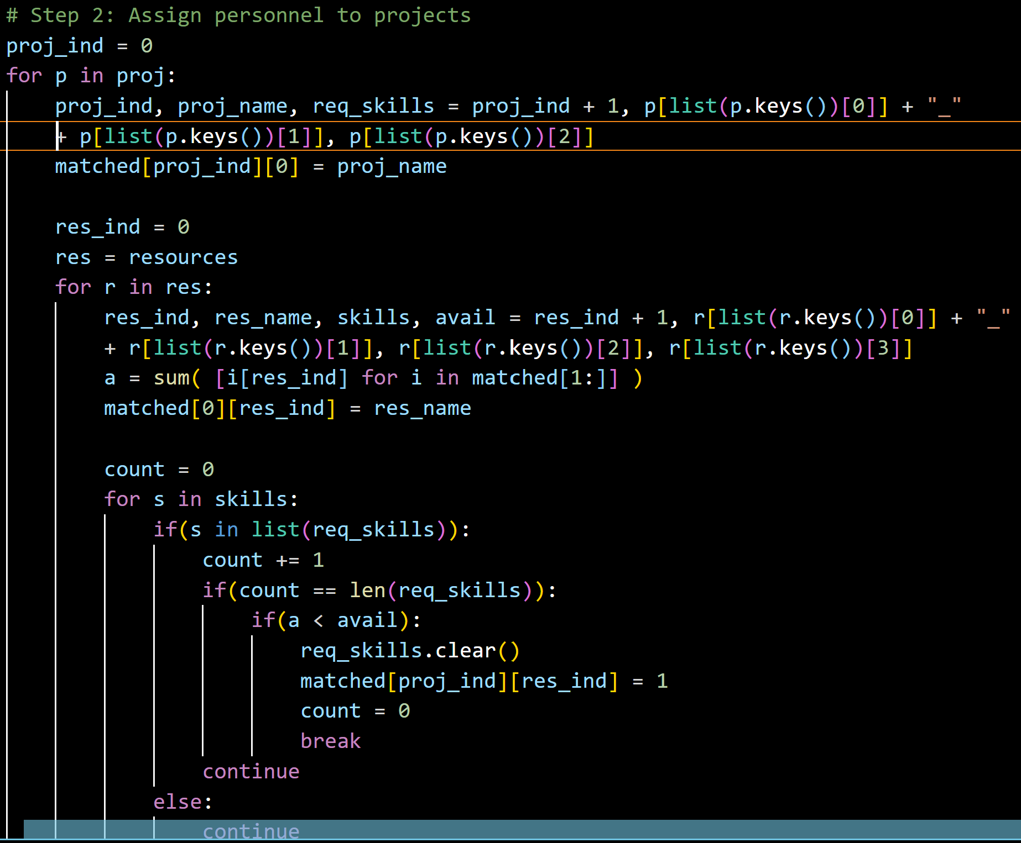
Step 2 : Assign personnel
Assign personnel to projects
Skill

Slide 8
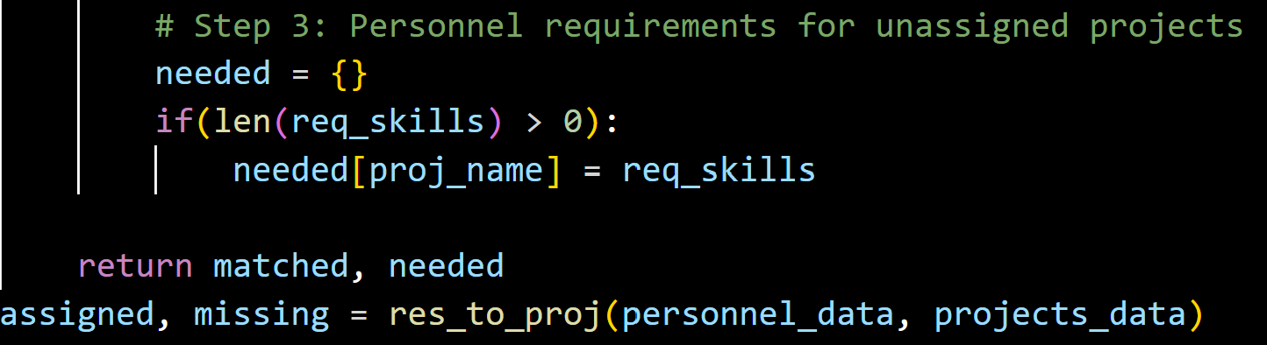
Step 3: Needed for unassigned projects
Describe personnel for unassigned projects
Skills

Slide 9
Input Data (1)
Personnel / Resources
Projects

Slide 10
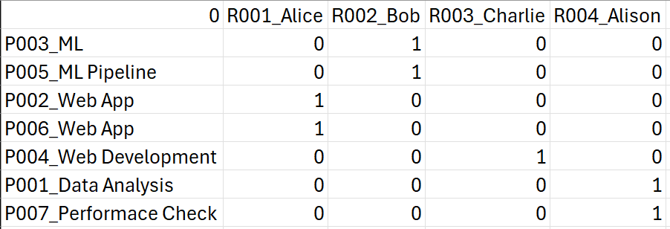
Result (1)

Slide 11
Input Data (2)
Personnel / Resources
Projects

Slide 12
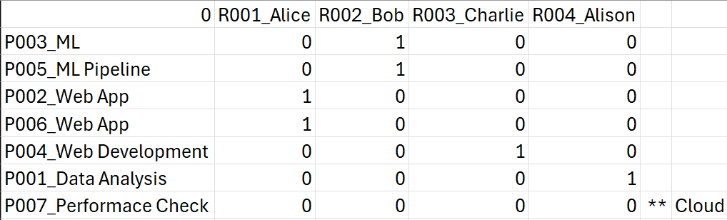
Result (2)

Slide 13
Takeaways
Dynamic Programming
Knapsack Problem
Inventory Problem
Tabulation (Top-to-Down)

